Slide 1


Department of BES-1
Data structures
24SC1203
Topic:
BINARY SEARCH TREE
(Search,Max,Min operations)
Session - 28

Slide 2



AIM OF THE SESSION
To familiarize students with the basic concept of Binary search tree
INSTRUCTIONAL OBJECTIVES
This Session is designed to:
Demonstrate to search a node in BST
Demonstrate to find out Maximum and Minimum node in BST
LEARNING OUTCOMES
At the end of this session, you should be able to:
Summarize the concept of binary search tree
Search a node in BST
Find out Maximum node in BST
Find out Minimum node in BST

Slide 3
INTRODUCTION
Search a node in BST:
Algorithm:
1 If root is NULL, print "Tree does not exist " and stop.
2. Otherwise:
If root->data is equal to key:
  Print "Key found: [key]" and stop.
Else if key is less than root->data:
  Call Search recursively on the left subtree (root->left).
Else if key is greater than root->data:
  Call Search recursively on the right subtree (root->right).

Slide 4
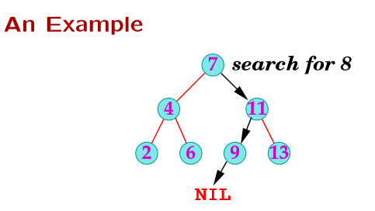
DESCRIPTION
Search a node in BST:

Slide 5
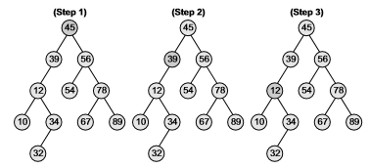
DESCRIPTION
Search a node in BST:
Ex: Searching a node 12 in BST

Slide 6
DESCRIPTION
To find Maximum Element in BST:
Algorithm:
1. If root is NULL:
Return INT_MIN (indicating the tree is empty or an error condition).
2. Otherwise:
If root->right is NULL:
  Return root->data (current node contains the maximum value as there is no right child).
Else:
  Call SearchMax recursively on the right subtree (root->right).

Slide 7
DESCRIPTION
  To find Minimum Element in BST:
  Algorithm
  1.If root is NULL:
    Return INT_MAX (indicating the tree is empty or an error condition).
  2.Otherwise:
    If root->left is NULL:
      Return root->data (current node contains the minimum value as there is no left child).
    Else:
      Call SearchMin recursively on the left subtree (root->left).

Slide 8
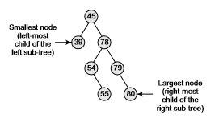
DESCRIPTION
To find Minimum Element in BST:

Slide 9
SELF-ASSESSMENT QUESTIONS
1. Which of the following is correct to find the maximum element in a BST?
A. Traverse the left subtree until NULL is reached.
B. Traverse the right subtree until NULL is reached.
C. Compare all the elements in the tree to find the maximum.
D. Start at the leaf nodes and work upwards.
2.If the BST is empty, what value is commonly returned as a sentinel when finding the maximum or minimum?
A. 0
B. INT_MAX for minimum and INT_MIN for maximum
C. NULL
D. The value of the root node

Slide 10
TERMINAL QUESTIONS
1. How to find Minimum node in BST
2.How to find Maximum node in BST
3. How to Search a node in BST

Slide 11
ACTIVITIES/ CASE STUDIES/ IMPORTANT FACTS RELATED TO THE SESSION
Add the following values one at a time to an initially empty binary search tree :
10,23,85,44,26,89,62,45,89
2. Write an Algorithm for finding a key element in a Binary Search Tree (BST).
.

Slide 12
REFERENCES FOR FURTHER LEARNING OF THE SESSION
Reference Books:
  "Mark Allen Weiss, Data Structures and Algorithm Analysis in C, 2010 , Second Edition, Pearson Education.
  2. Ellis Horowitz, Fundamentals of Data Structures in C: Second Edition, 2015.
  A.V.Aho, J. E. Hopcroft, and J. D. Ullman, “Data Structures And Algorithms”, Pearson Education, First Edition Reprint 2003.
  Sites and Web links:
1. https://nptel.ac.in/courses/106102064
2. https://in.udacity.com/course/intro-to-algorithms--cs215
3. https://www.coursera.org/learn/data-structures?action=enroll

Slide 13
THANK YOU
Team – Data structures

